Slide 1
Lecture #1 COMP 116: Object Oriented Programming
1st Year, 2nd Semester
Group: Computer Science
25th April, 2018

Slide 2
What today?
Introducing COMP 116: Object Oriented Programming
Course, marking scheme and code of conduct
Revision of C
Definition of OOP
What is object?
Quick Work for you

Slide 3
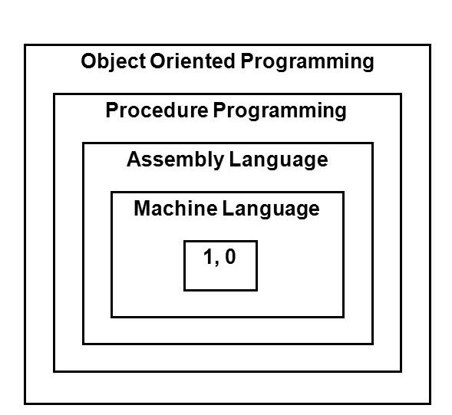
Software evolution

Slide 4
Machine language
0000 1001 1100 0110 1010 1111 0101 1000
1111 0101 1000 0000 1001 1100 0110
1100 0110 1010 1111 0101 1000 0000 1001
0101 1000 0000 1001 1100 0110 1010 1111
Notes:
The only language computer can understand directly.

Slide 5
Assembly language
GCD: TST B
BEQ SIMPLE
MOV A, R5
SXT R4
DIV B, R4
MOV B,A
MOV R5, B
CALL GCD
SIMPLE: RETURN

Slide 6
Procedure Oriented Programming (POP)
Conventional programming languages like COBOL, FORTRAN, PASCAL, C.
Use a series of instructions or statements which are sequential from beginning to the end.
POP basically consists of writing a list of instructions for the computer to follow and organizing these instructions into groups called functions.
More important to functions and less to data.

Slide 7
OOP is all about understanding programming, the way you think about the world.
Notes:
Meant to make thinking about program easier.

Slide 8
Program = Data + Action

Slide 9
#include<stdio.h>
int main()
{
int a, b, c;
printf("Enter two numbers to add\n");
scanf("%d%d", &a, &b);
c = a + b;
printf("Sum of the numbers = %d\n", c);
return 0;
}

Slide 10
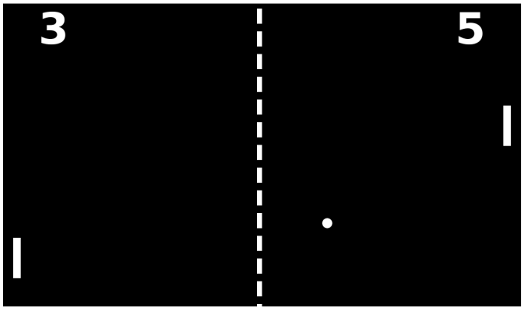

Slide 11
action
data
entity that wraps data + action

Slide 12
The fundamental idea behind object-oriented languages is
to combine into a single unit
both data and the functions that operate on that data.
Such a unit is called an object.

Slide 13
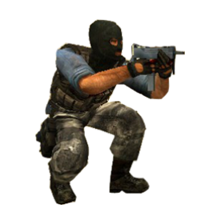
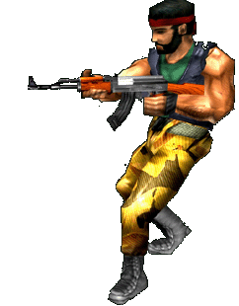
Data: health position status Functions: run() shoot() walk() isDead()

Slide 14
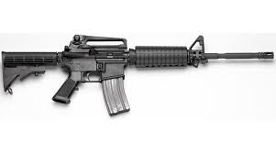
Data: noofBullets
typeofGun Functions: shoot() reload() switchToType()
Notes:
For YOU !!!!

Slide 15
Quick Work
For any software application you can imagine, write down an object. What could be the data and functions associated with it.

Slide 16
Definitions of OOP
Object Oriented Programming (OOP) is a programming paradigm based on the concept of "objects", which may contain data, in the form of fields, often known as attributes; and code, in the form of procedures, often known as methods.
- Wikipedia

Slide 17
Definitions of OOP
Object Oriented Programming (OOP) is an approach that provides a way of modularizing programs by creating a partitioned memory area for both data and functions that can be used as templates for creating copies of such modules on demand.
- E Balaguruswamy

Slide 18
OOP is not a programming language, it is an IDEA.
Notes:
Meant to make thinking about program easier.

Slide 19
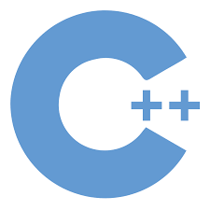


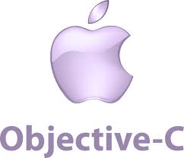


Slide 20
OOP Paradigm
Emphasis is on data rather than procedure.
Programs are divided into what are known as objects.
Data structures are designed such thatthey characterize the objects.
Data is hidden and cannot be accessed by external functions.
Objects may communicate with each other through functions.
New data and functions can be easily added whenever necessary.

Slide 21
Object A
Object B
Data
Data
Functions
Communication
Functions
Object C
Functions
Data
Figure: Organization of data and functions in OOP

Slide 22
Tip #1. Start with basics.

Slide 23
Tip #2. Learn by doing.

Slide 24
Tip #3. Don’t just read code,write code.

Slide 25
Tip #4. Don’t be afraid of new challenges.

Slide 26
Tip #5. Build programs one step at a time.

Slide 27
Tip #6. Comment your code.

Slide 28




Tip #8. Online resources

Slide 29
In next class...........
Features of OOP
Classes
Data abstraction and encapsulation
Inheritance
Polymorphism
Dynamic binding
Message passing

